Slide 1
QuickSort Algorithm
Presented by: Shahd Wael 222045

Slide 2
How Was QuickSort Invented
QuickSort was invented by Tony Hoare
As a result of thinking about problems of translating languages
The first idea Tony had for doing sorting was something like Bubble Sort

Slide 3
What is Bubble Sort Comparing consecutive items
2
7
5
10
9
Time Complexity: O(n²)

Slide 4
How Does QuickSort Work In Divide and Conquer QuickSort = pivot
Output Sorted
Correct position in final, sorted array
Items to the left are smaller
Items to the right are larger

Slide 5
Example
Input
2
6
5
3
8
7
1
0
pivot

Slide 6
From Input to Output
item from left that is larger than pivot
item from right that is smaller than pivot
2
6
5
3
8
7
1
0
Swap item from left and pivot
2
1
0
3
8
7
6
5

Slide 7
Divide and Conquer
2
1
0
3
8
7
6
5
8
7
6
5
6
5
7
8

Slide 8
Divide and Conquer
Output Sorted
0
1
2
3
5
6
7
8

Slide 9
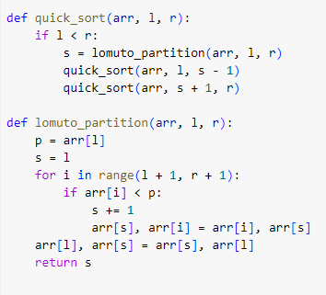
Algorithm

Slide 10
Analysis
T(n) = 2T(n/2)+n
= 2 [2T(n/2/2) + n/2]+ n
= 4T(n/4)+2n
= 4 [2T(n/4/2) + n/4]+ 2n
= 8T(n/8)+3n
…
T(n) = 2^{k}.T(n/2^{k})+ K.n
Let 2^{k} = n
log2^{k} = logn
klog2 = logn
k = logn
T(n) = n.T(n/n)+ logn.n
= n.T(1)+n.logn
=n.1 + nlogn
= n logn
O(n log n)
Best case: O(n log n)
Worst case: Θ(n²)

